Slide 1
Information storage &retrieval
Eng : Esraa Maged

Slide 2
Creative gang
Ahmed megahed
Mohamed elfiky
Youssef Yasser
Mina kamel
Mohmaed elshamey

Slide 3
Simple search engine
preprocessing steps:
Implement three search methods:
o Document Term Incidence
o Inverted Index
o TF-IDF with Cosine Similarity
O cosine Similarity

Slide 4
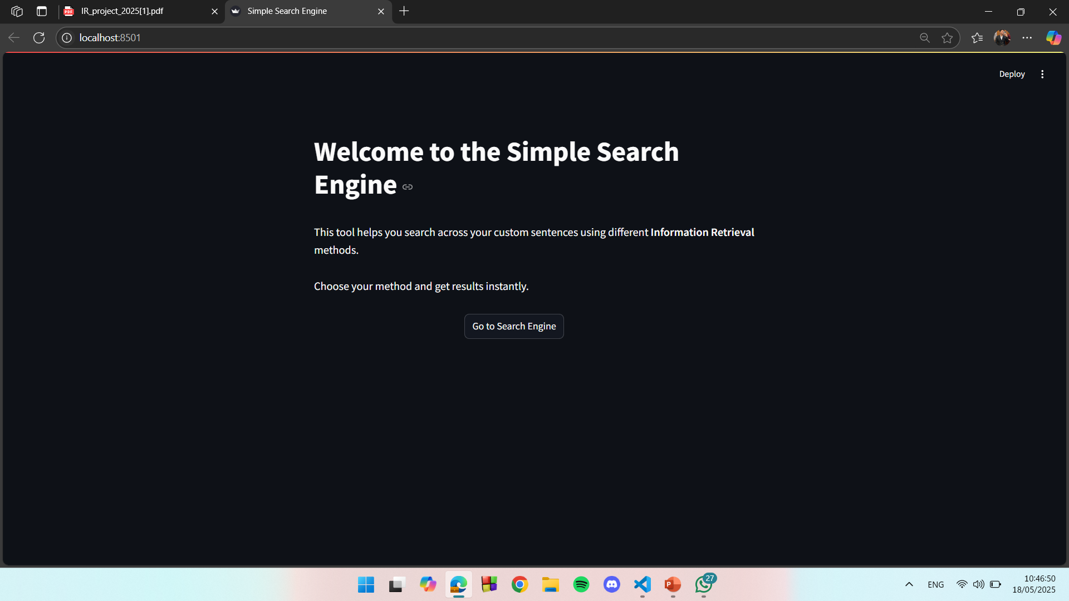
Welcome

Slide 5
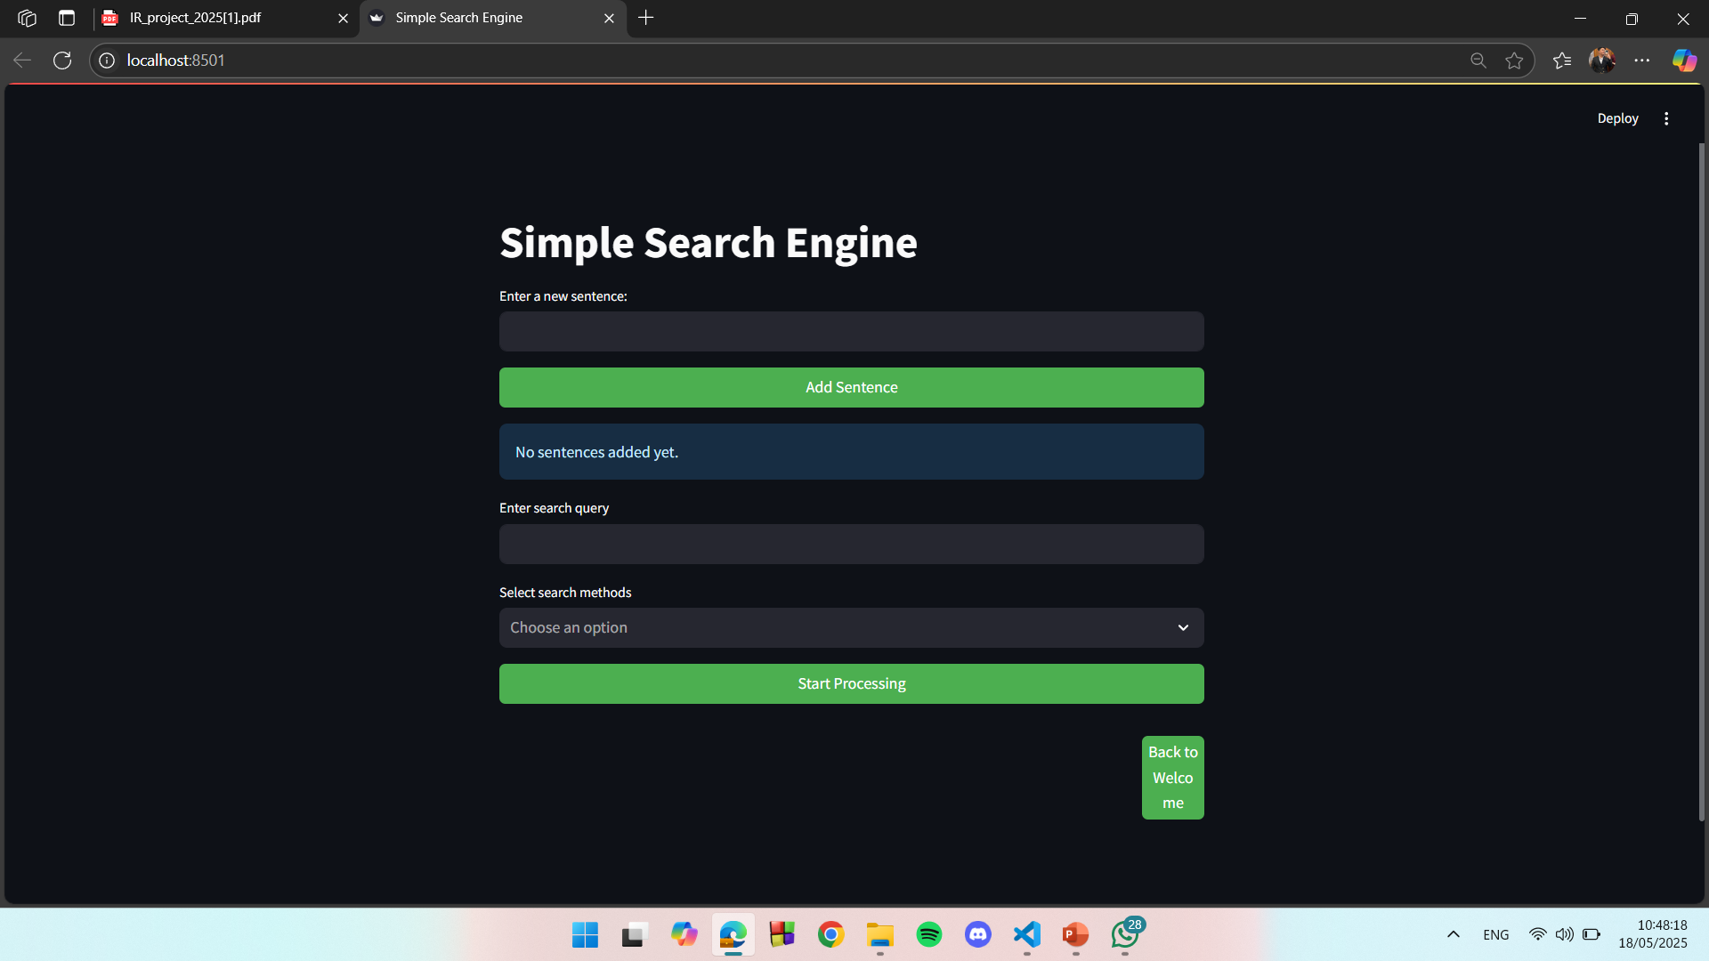
Simple search engine

Slide 6
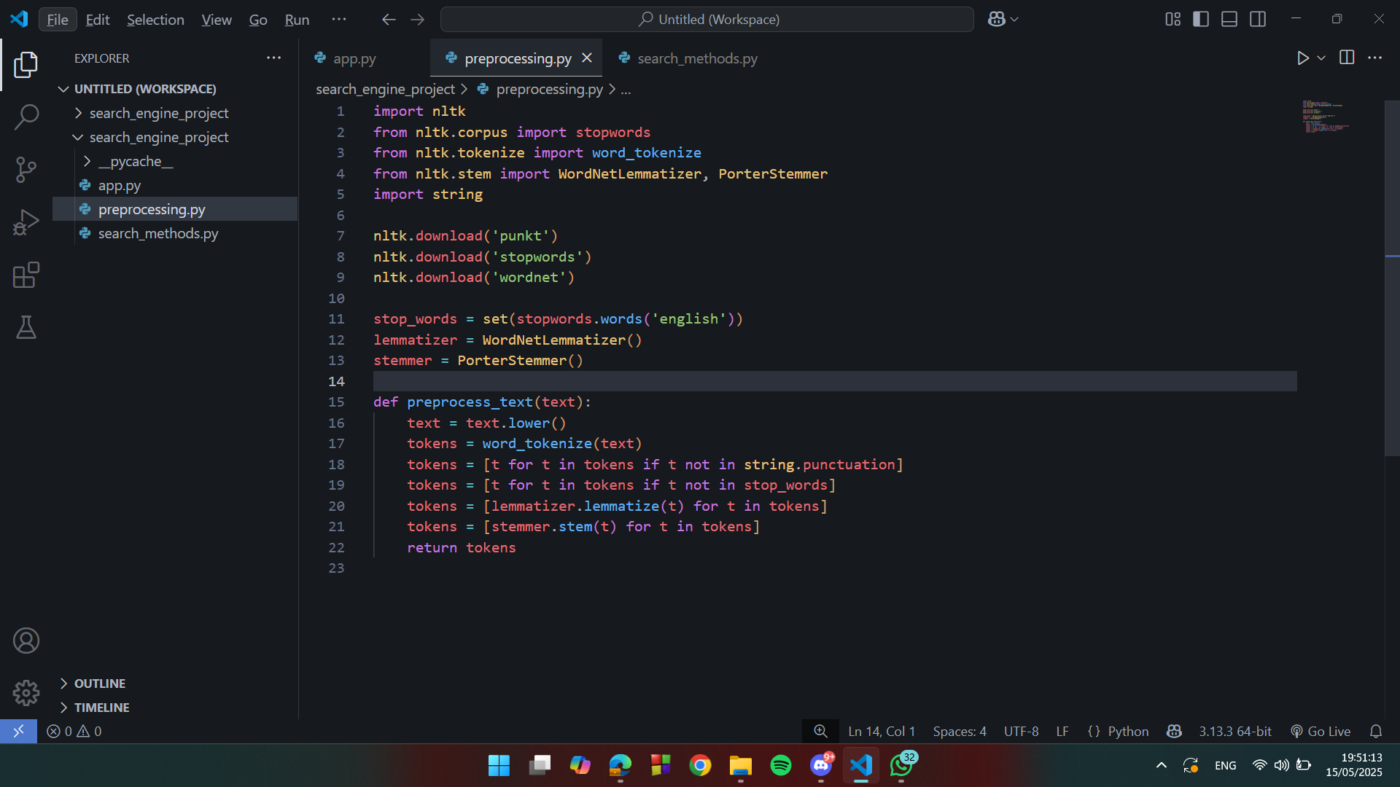
Code of preprossing

Slide 7
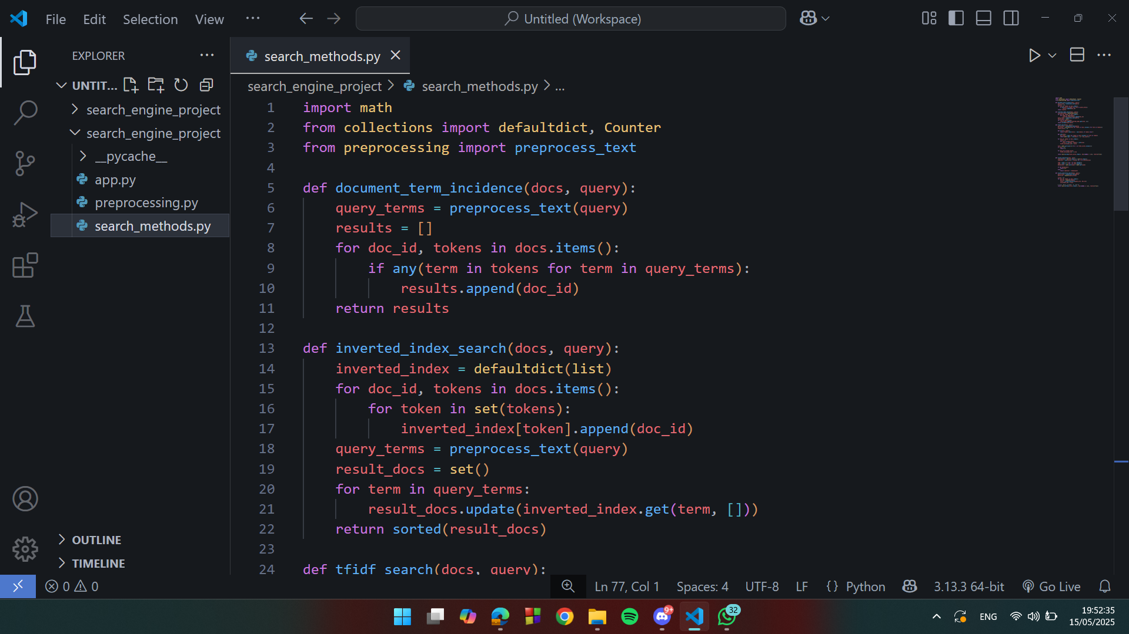
Code of document_term_incidence

Slide 8
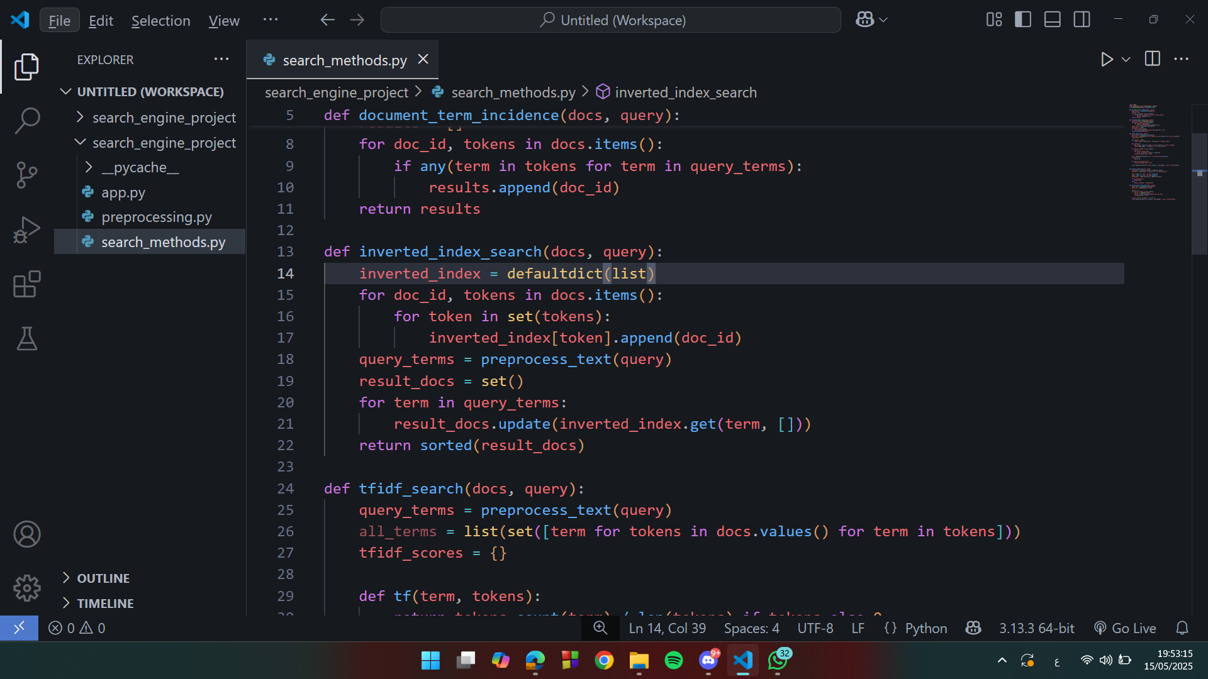
Code of inverted_index_search

Slide 9
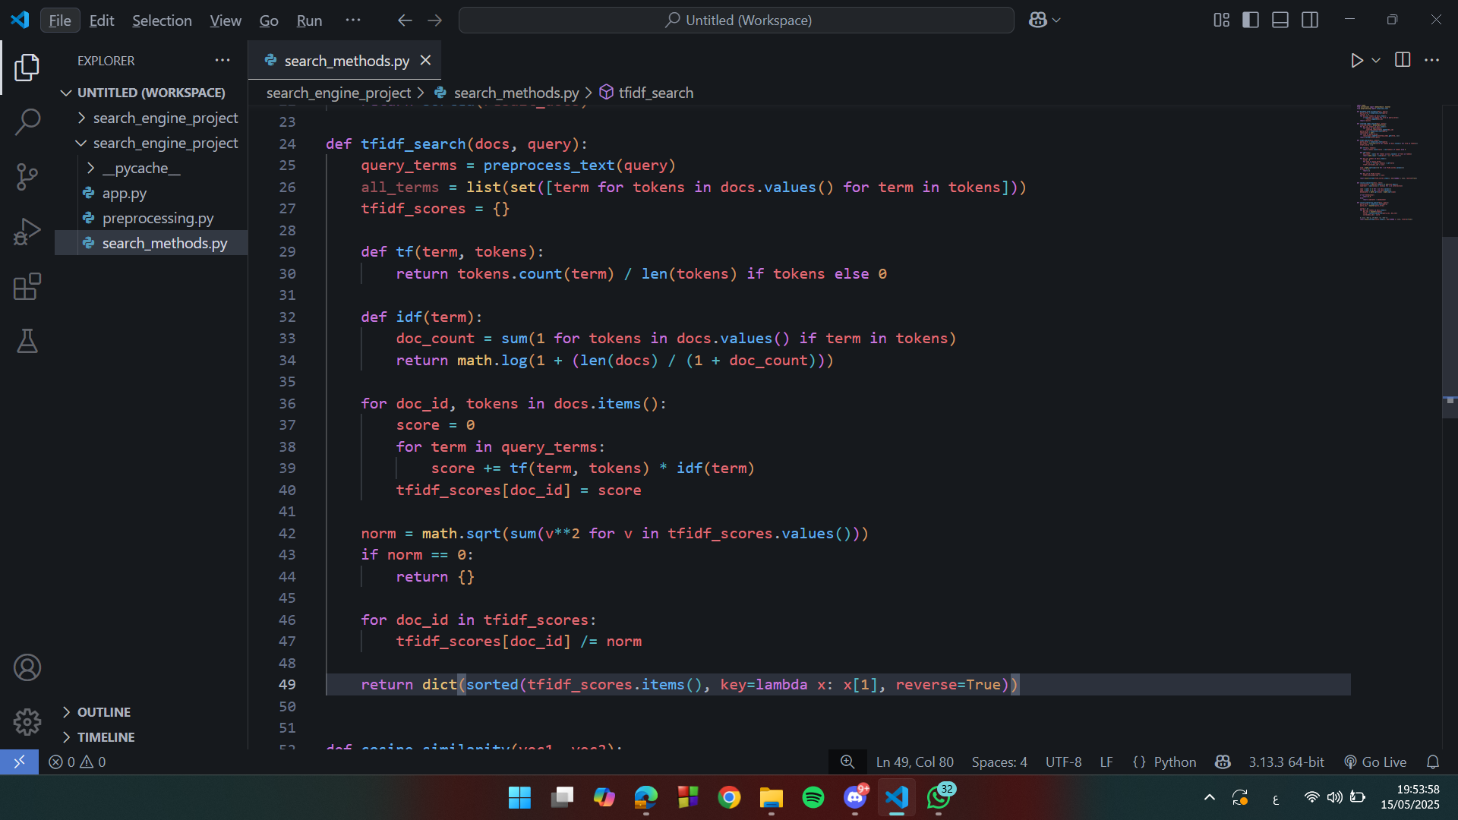
code of TF-IDF

Slide 10
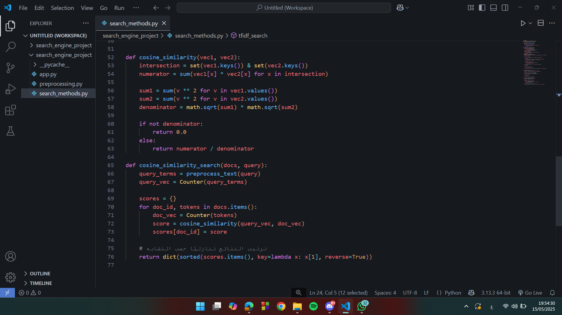
Code of Cosine Similarity

Slide 11
Thanks

